Slide 1
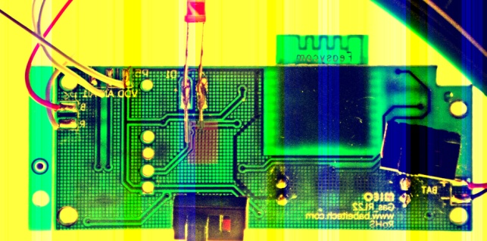
VDD
AI0
AI1
B
R
AI0
B
R
AI1
VDD
Flame King propane scale

Slide 2
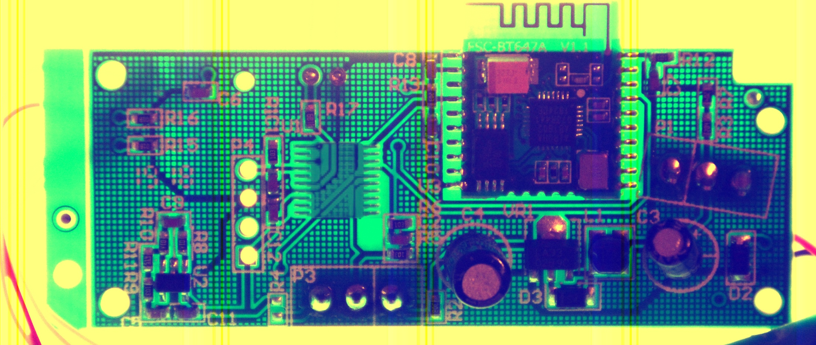
LED (3.3v=on)
Analog
Weight
Reading
3.3v
(regulated)
Ground
Desolder
Microcontroller
Desolder
Bluetooth Board

